Slide 1
Review of Mathematical Foundations
Calculus, Set Theory, and Linear Algebra
Notes:
U2 Review of Mathematical Foundations
Module 1: Part 1 of the review, covering calculus, set theory, and linear algebra.

Slide 2


Objective
Objective
Objective
Review basic notations from Calculus & Set Theory
Review key Linear Algebra concepts and operations
Notes:
U2 Mathematical Foundations:
Module 1: Basic notations from Calculus & Set Theory; Review of Probability Theory

Slide 3
Basic Notations from Calculus (1/3)
Derivative of f(x) with respect to x
Partial derivative of a function f(x,y,…) with respect to x
Note: the function may be scalar-valued or vector-valued

Slide 4

Basic Notations from Calculus (2/3)
ℜ^{d} : d-dimensional Euclidean space.
Gradient operator in ℜ^{d} : $∇$

Slide 5
Basic Notations from Calculus (3/3)
The integral of f(x) between a and b
The argmin or argmax notation

Slide 6
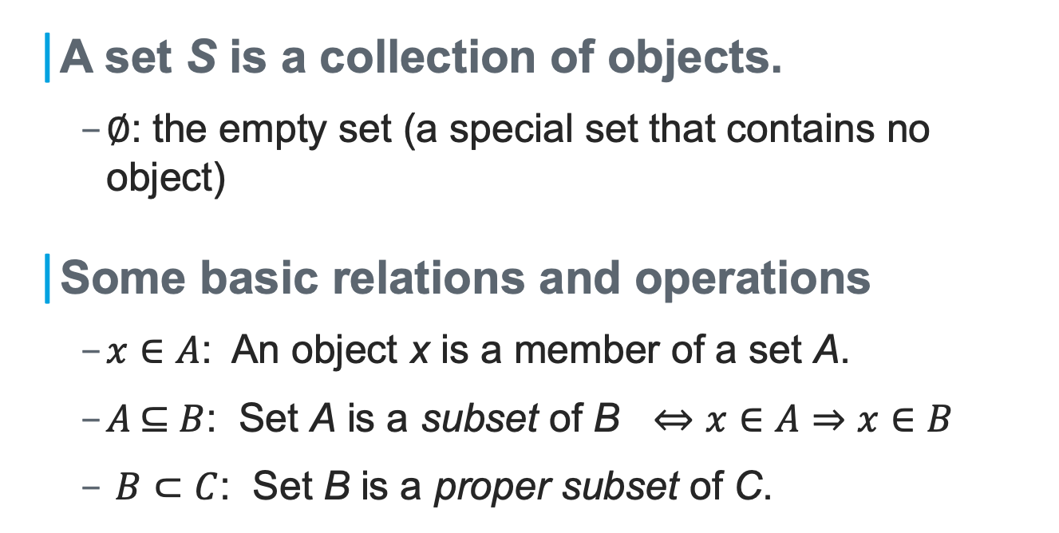
Basic Notations from Set Theory (1/2)
A set S is a collection of objects.
$∅$: the empty set (a special set that contains no object)
Some basic relations and operations
$x∈A$: An object x is a member of a set A.
$A\text{ ⊆ }B$: Set A is a subset of B $⇔x∈A⇒$ $x∈B$
$B⊂C$: Set B is a proper subset of C.

Slide 7
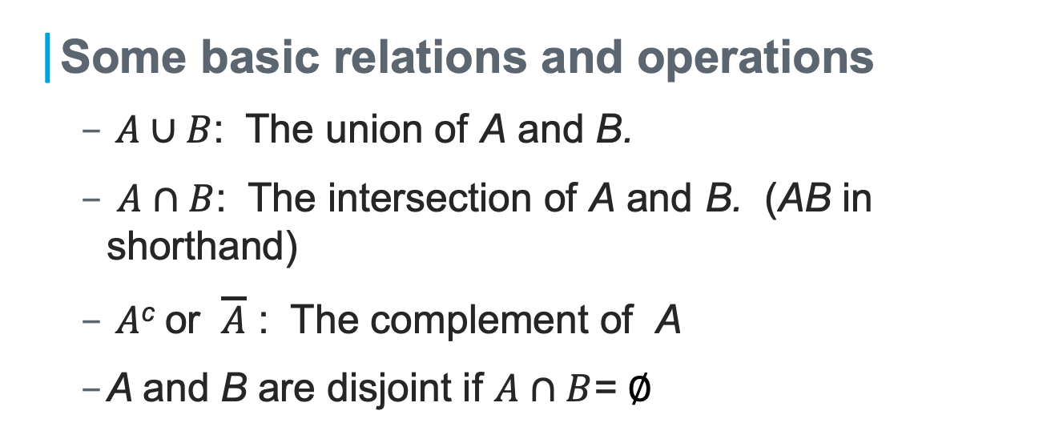
Basic Notations from Set Theory (2/2)
Some basic relations and operations
$A∪B$: The union of A and B.
$A∩B$: The intersection of A and B. (AB in shorthand)
$A$^{c} or $\overline{A}$ : The complement of A
A and B are disjoint if $A∩B$= $∅$

Slide 9
Linear Algebra: Basic Notations (1/4)
A d-dimensional column vector x and its transpose x^{t}
n by d matrix M and its d by n transpose M^{t}

Slide 10
Linear Algebra: Basic Notations (2/4)
A square matrix M is symmetric if
Multiplying a vector by a matrix: Mx = y
Multiplying two matrices M₁ and M₂

Slide 11
Linear Algebra: Basic Notations (3/4)
The identity matrix I of d by d
Inner product of two vectors x^{t}y
Outer product of two vectors xy^{t}

Slide 12
Linear Algebra: Basic Notations (4/4)
The length or Euclidean norm of a vector x, denoted ||x||
Normalized vector, ||x|| = 1

Slide 13
Matrix: Additional Definitions (1/2)
Determinant of a matrix M: denoted |M| or det(M)
Look at size 2x2
What about size 3x3 and above?
Trace of a matrix
Notes:
A determinant can be expanded "by minors" to obtain. E.g., singular matrices will have det(M) = 0
These are well-defined only for square matrices.

Slide 14
Matrix: Additional Definitions (2/2)
Matrix inversion M⁻¹
Eigenvectors and eigenvalues of M

Slide 15
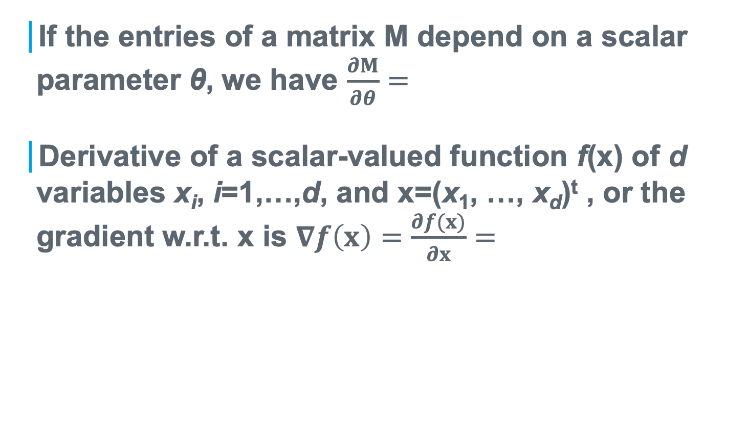
Derivatives Involving Matrices (1/3)
If the entries of a matrix M depend on a scalar parameter θ, we have $\frac{∂M}{∂θ}=$
Derivative of a scalar-valued function f(x) of d variables x_{i}, i=1,…,d, and x=(x₁, …, x_{d})^{t} , or the gradient w.r.t. x is $∇f\left(x\right)=\frac{∂f(x)}{∂x}=$

Slide 16
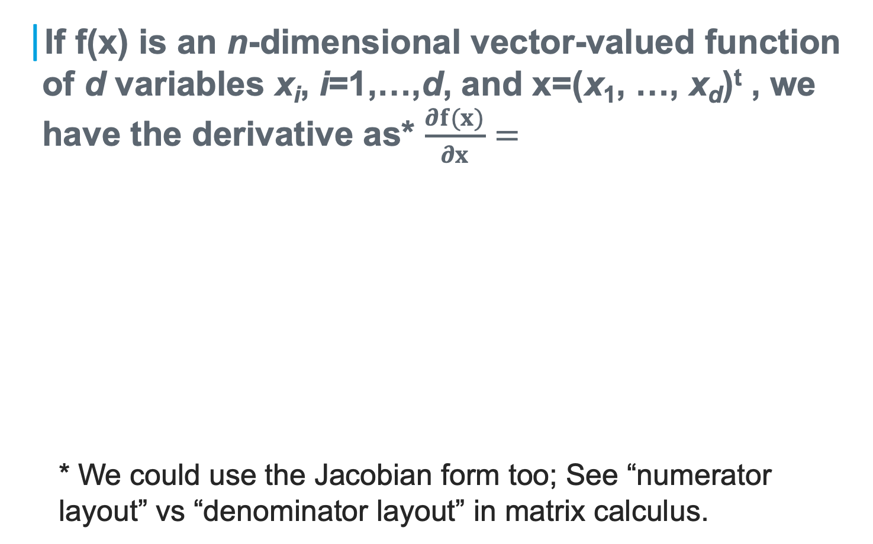
Derivatives Involving Matrices (2/3)
If f(x) is an n-dimensional vector-valued function of d variables x_{i}, i=1,…,d, and x=(x₁, …, x_{d})^{t} , we have the derivative as* $\frac{∂f(x)}{∂x}=$
* We could use the Jacobian form too; See “numerator layout” vs “denominator layout” in matrix calculus.
Notes:
Here we are using the denominator layout

Slide 17
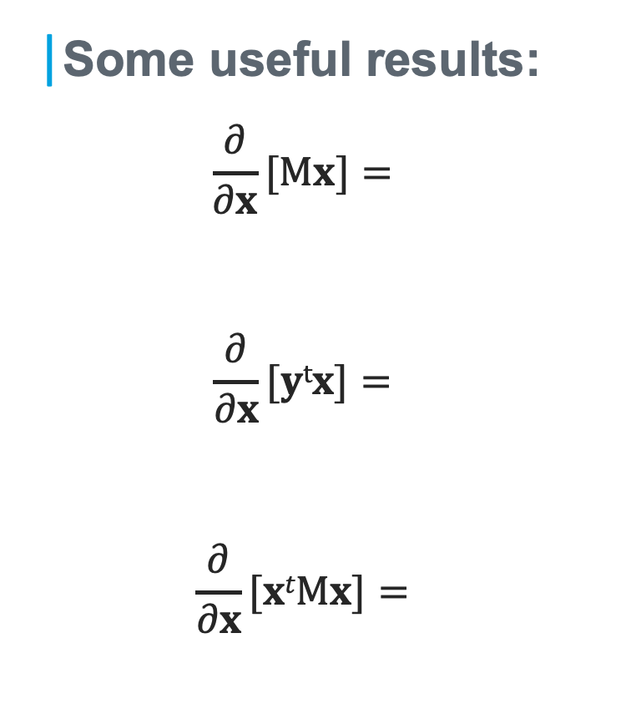
Derivatives Involving Matrices (3/3)
Some useful results:
$$\frac{∂}{∂x}[Mx]=$$
$$\frac{∂}{∂x}[ytx]=$$
$$\frac{∂}{∂x}[xtMx]=$$

Slide 19
Review of Mathematical Foundations
Basics in Probability Theory
Notes:
U2 Review of Mathematical Foundations
Module 2: Part 2 of the review, covering basics in probability theory.

Slide 20
Objective
Objective
Objective
Define Probability Space
Discuss Conditional Probability and Bayes Rule
Notes:
U2 Mathematical Foundations:
Module 2: Part 2 of the review: Define Probability Space & Discuss Conditional Probability & Bayes Rule

Slide 21
Probability Space (1/2)
A probability space is a triplet (Ω, ℬ, P) that is used to model a process or an experiment with random outcomes.
The sample space Ω is the set of all possible outcomes of an experiment
Consider two different experiments
(1) Tossing a coin; (2) Tossing a die

Slide 22
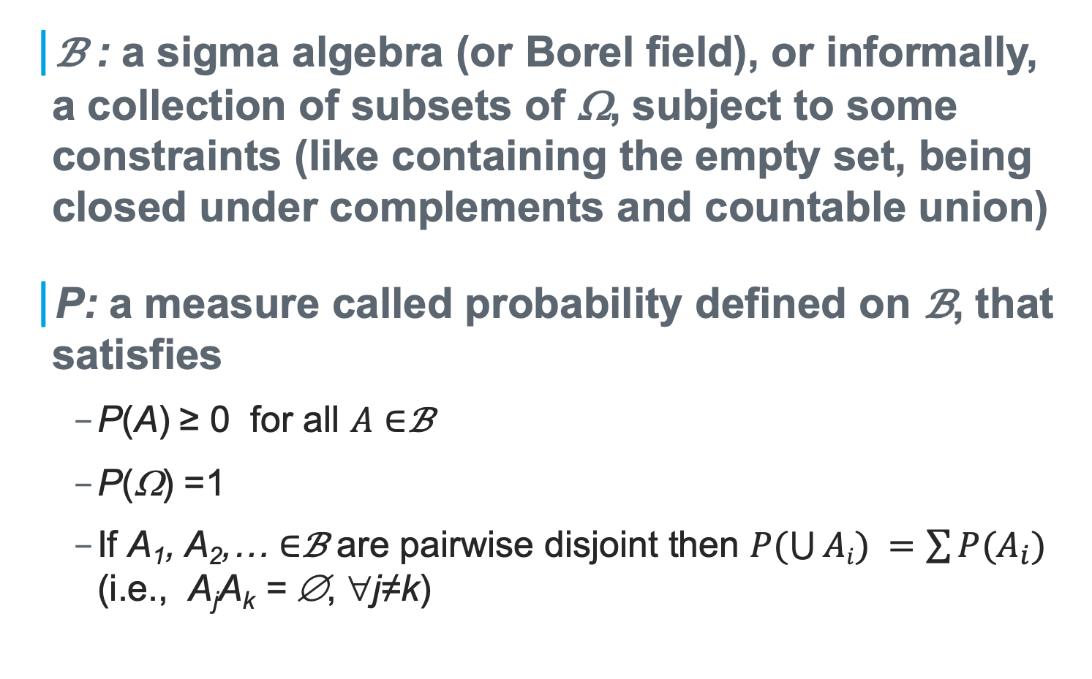
Probability Space (2/2)
ℬ : a sigma algebra (or Borel field), or informally, a collection of subsets of Ω, subject to some constraints (like containing the empty set, being closed under complements and countable union)
P: a measure called probability defined on ℬ, that satisfies
P(A) ≥ 0 for all $A∈$ℬ
P(Ω) =1
If A₁, A₂,… $∈$ℬ are pairwise disjoint then $P(\bigcup{Ai}) =\sum{P(A_{i})}$ (i.e., A_{j}A_{k} = ∅, ∀j≠k)

Slide 23
Conditional Probability
Let (Ω, ℬ, P) be a probability space, and let H∈ℬ with P(H)>0. For any B∈ℬ, we define P(B|H) = P(BH) / P(H) and call P(B|H) the conditional probability of B, given H.

Slide 24

The Total Probability Rule
Let (Ω, ℬ, P) be a probability space, and let {H_{j}} be pairwise disjoint events in ℬ (i.e., H_{j}H_{k} = ∅, ∀j≠k) and $\bigcup{j\text{=}\text{1,…,∞}Hj}$ = Ω. Suppose P(H_{j})>0, ∀j, then P(B) = ∑ _{j=1,…,∞} P(H_{j})P(B|H_{j})
Such {H_{j}} is called a partition of Ω.

Slide 25
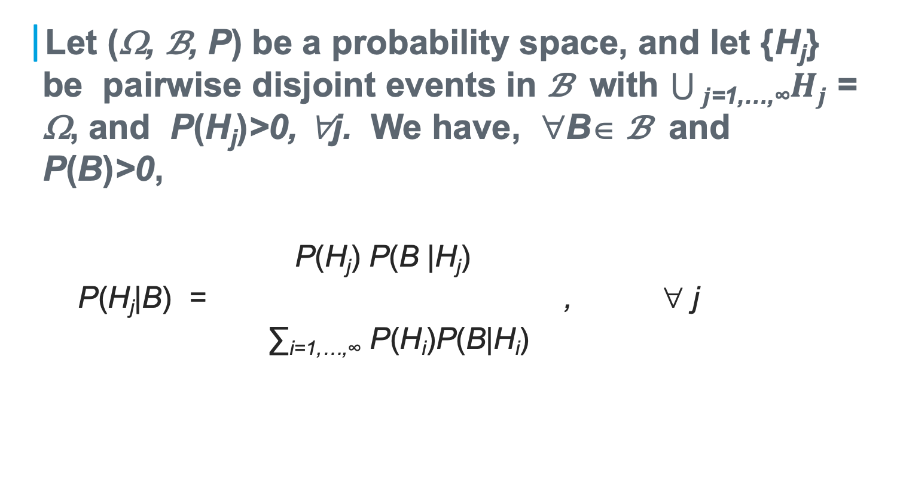
The Bayes Rule
Let (Ω, ℬ, P) be a probability space, and let {H_{j}} be pairwise disjoint events in ℬ with $\bigcup{j\text{=}\text{1,…,∞}Hj}$ = Ω, and P(H_{j})>0, ∀j. We have, ∀B∈ ℬ and P(B)>0,
P(H_{j}) P(B |H_{j})
P(H_{j}|B) = , ∀ j
∑_{i=1,…,∞} P(H_{i})P(B|H_{i})

Slide 26
Independence of Events
Let (Ω, ℬ, P) be a probability space, ∀A,B ∈ℬ , we say A and B are independent if P(AB) = P(A)P(B).

Slide 28
Review of Mathematical Foundations
Random Variables and Common Distributions
Notes:
U2 Review of Mathematical Foundations
Module 3: Random variables and common distributions.

Slide 29
Objective
Objective
Review random variables & their distributions
Notes:
U2 Mathematical Foundations:
Module 3: Review random variables & distributions

Slide 30
Discrete Random Variables
Let x be a discrete random variable that can take any of the m different values in the set V={v₁, v₂, …, v_{m}} with respective probabilities {p₁, p₂, …, p_{m}}, i.e., p_{i}=Prob[x= v_{i}].
p_{i} ≥ 0, ∑ _{j=1,…,m} p_{j} = 1
Probability Mass Function P(x) is used to represent the set of probabilities {p₁, p₂, …, p_{m}}
P(x) ≥0, ∑ _{x in V} P(x) = 1
Notes:
With the preparation, we will present random variables and their distributions.

Slide 31
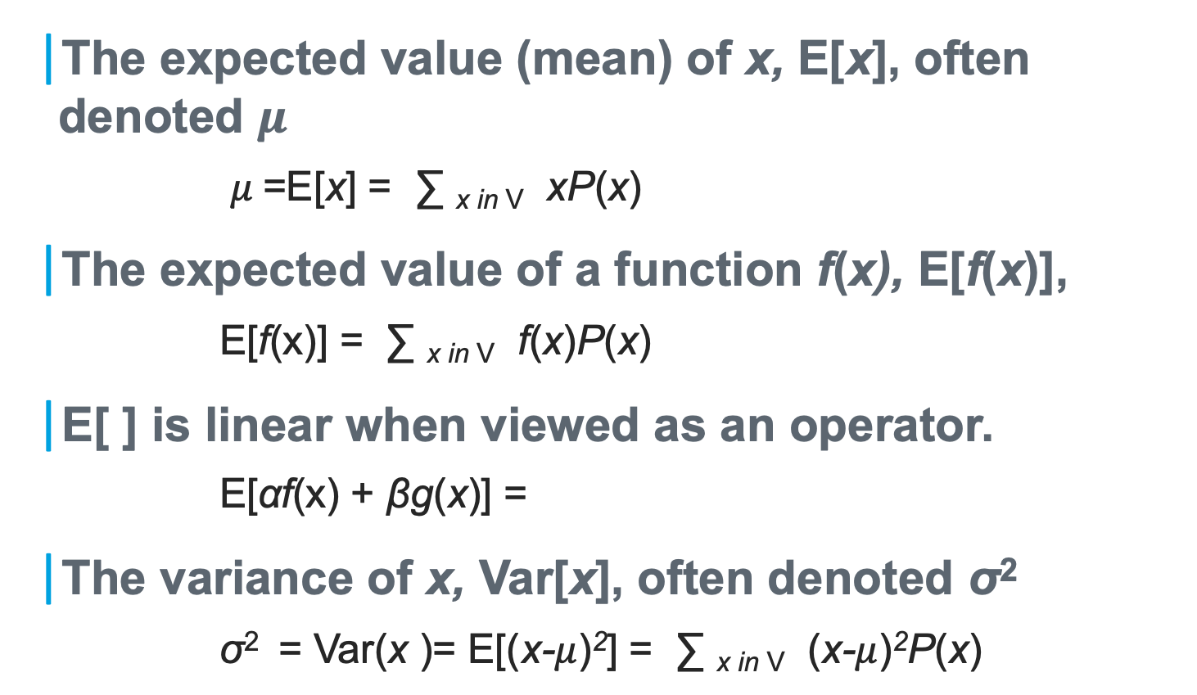
Expected Value (Means) & Variance
The expected value (mean) of x, E[x], often denoted $μ$
$μ$=E[x] = ∑ _{x in V} xP(x)
The expected value of a function f(x), E[f(x)],
E[f(x)] = ∑ _{x in V} f(x)P(x)
E[ ] is linear when viewed as an operator.
E[αf(x) + βg(x)] =
The variance of x, Var[x], often denoted $\text{σ}\text{2}$
$\text{σ}\text{2 }$ = Var(x )= E[(x-$μ$)²] = ∑ _{x in V} (x-$μ$)²P(x)

Slide 32
Joint Distributions
Consider a pair of discrete random variables, x and y, taking values in V={v₁, v₂, …, v_{m}} and W={w₁, w₂, …, w_{n}} respectively.
(x, y) to take a pair of values (v_{i}, w_{j}) with probability p_{ij}
Or, we consider the joint probability mass function P(x, y)

Slide 33
Marginal Distributions
Knowing P(x, y), can we figure out P_{x}(x) or P_{y}(y)?
➔ The concept of marginal distribution for x and y respectively.

Slide 34
Statistical Independence
Random variables x and y are said to be statistically independent if and only if P(x, y) = P_{x}(x) P_{y}(y)

Slide 35

Covariance
Cov(x, y), often denoted σ_{xy}
Covariance matrix Σ, Σ $=E[\left(x−μ\right)\left(x−μ\right)t]$

Slide 36
Conditional Density
P(x|y) =
Similarly, we may write the Bayes Rule in terms of densities.

Slide 37
How about continuous random variables?
Instead of P(x), we have the probability density function (PDF) p(x)
Some properties of p(x):
The cumulative distribution function (CDF) F(x):

Slide 38
Continuous Random Variables
Mean, variance, etc., are similarly defined, via integrals.
Joint PDF p(x,y) of two variables
Marginal PDFs for x and y
If x ~ p_{x}(x) and y ~p_{y}(y) are independent p(x,y) =

Slide 39
Continuous Random Variables
Conditional PDF p(x|y)
Bayes rule for PDF:

Slide 41
Review of Mathematical Foundations
Common Densities
Notes:
U2 Review of Mathematical Foundations
Module 4: Part 4 of the review

Slide 42
Objective
Objective
Discuss common densities useful for machine learning application
Notes:
U2 Mathematical Foundations:
Module 4: Part 4 of the review: common densities.

Slide 43
Common Distributions
Uniform Distribution
Normal (Gaussian) Distribution

Slide 44
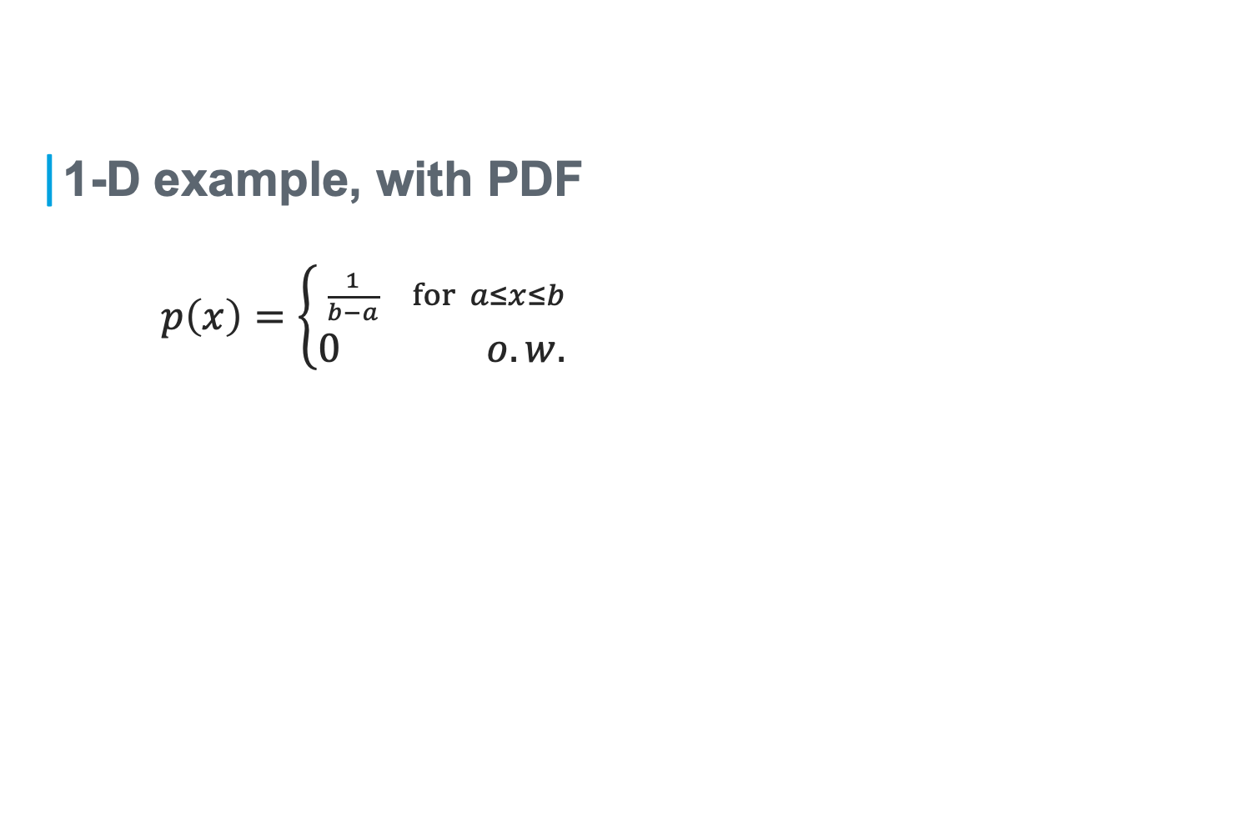
The Uniform Distribution, U(a, b)
1-D example, with PDF
$p\left(x\right)=\left\{\begin{matrix}\frac{1}{b−a} for a≤x≤b \\ 0 o.w. \end{matrix}\right.$

Slide 45
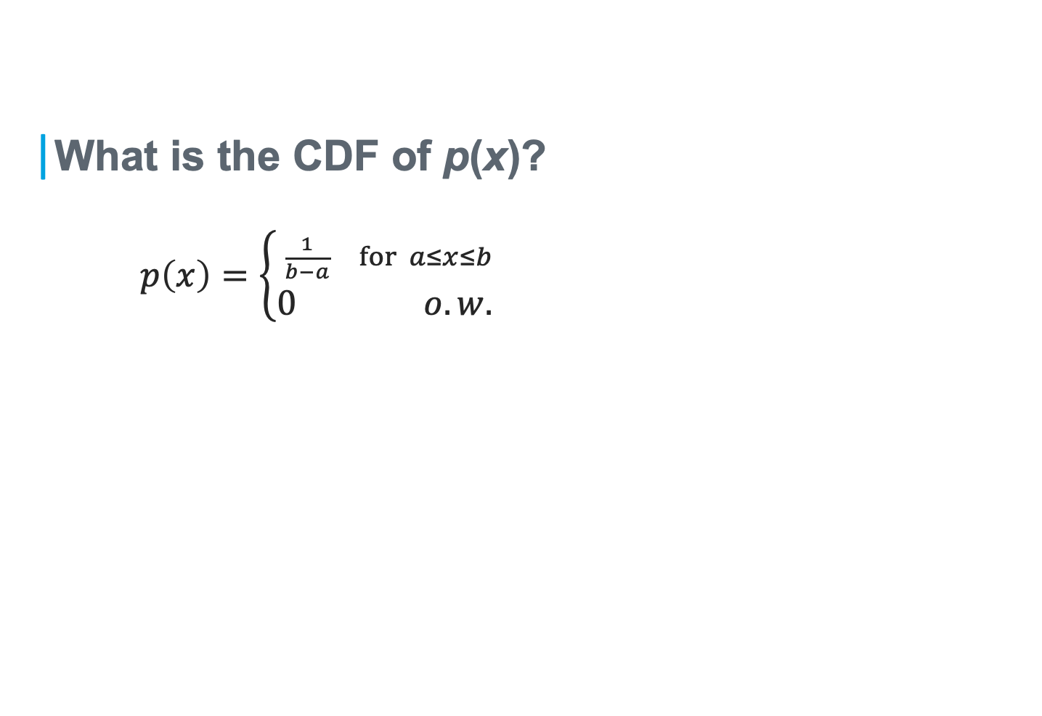
The Uniform Distribution, U(a, b)
What is the CDF of p(x)?
$p\left(x\right)=\left\{\begin{matrix}\frac{1}{b−a} for a≤x≤b \\ 0 o.w. \end{matrix}\right.$

Slide 46
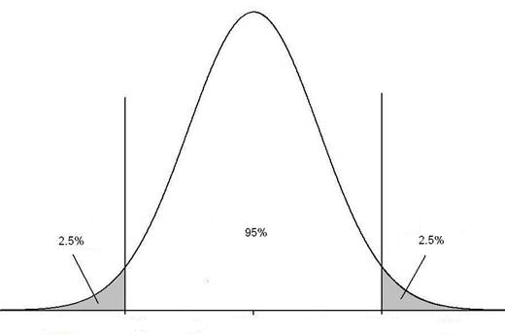


The Normal Distribution, N($μ,$σ²)
1-D example, with PDF
$$p\left(x\right)={\frac{1}{\sqrt{2π}σ}e}^{−\frac{\left(x−μ\right)2}{2σ2}}$$

Slide 47
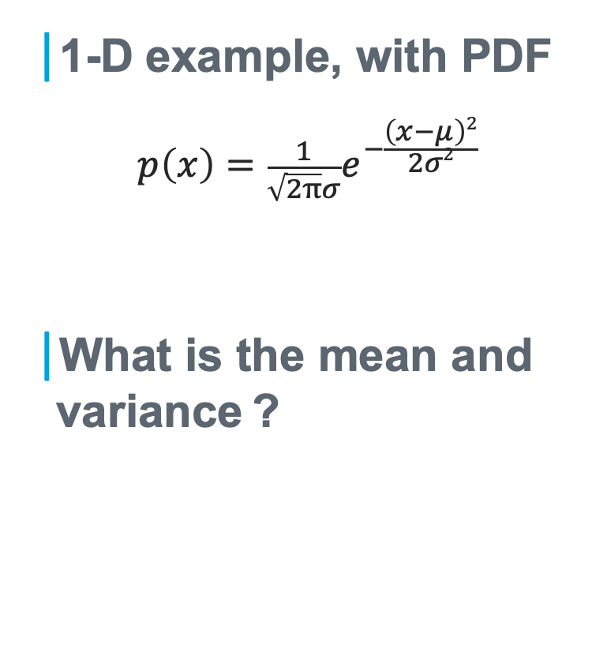
The Normal Distribution, N($μ,$σ²)
1-D example, with PDF
$$p\left(x\right)={\frac{1}{\sqrt{2π}σ}e}^{−\frac{\left(x−μ\right)2}{2σ2}}$$
What is the mean and variance ?

Slide 48

Standardized Normal Distribution
1-D example, with PDF
$p\left(x\right)={\frac{1}{\sqrt{2π}}e}^{−\frac{x2}{2}}$
What is the CDF?
The error function
$\operatorname{erf}\left(u\right)=\frac{2}{\sqrt{π}}\int_{0}^{u}{e^{−x^{2}}dx}$

Slide 49

CDF for General Normal Distribution
What is the CDF for N($μ,$σ²)?
$$p\left(x\right)={\frac{1}{\sqrt{2π}σ}e}^{−\frac{\left(x−μ\right)2}{2σ2}}$$

Slide 50
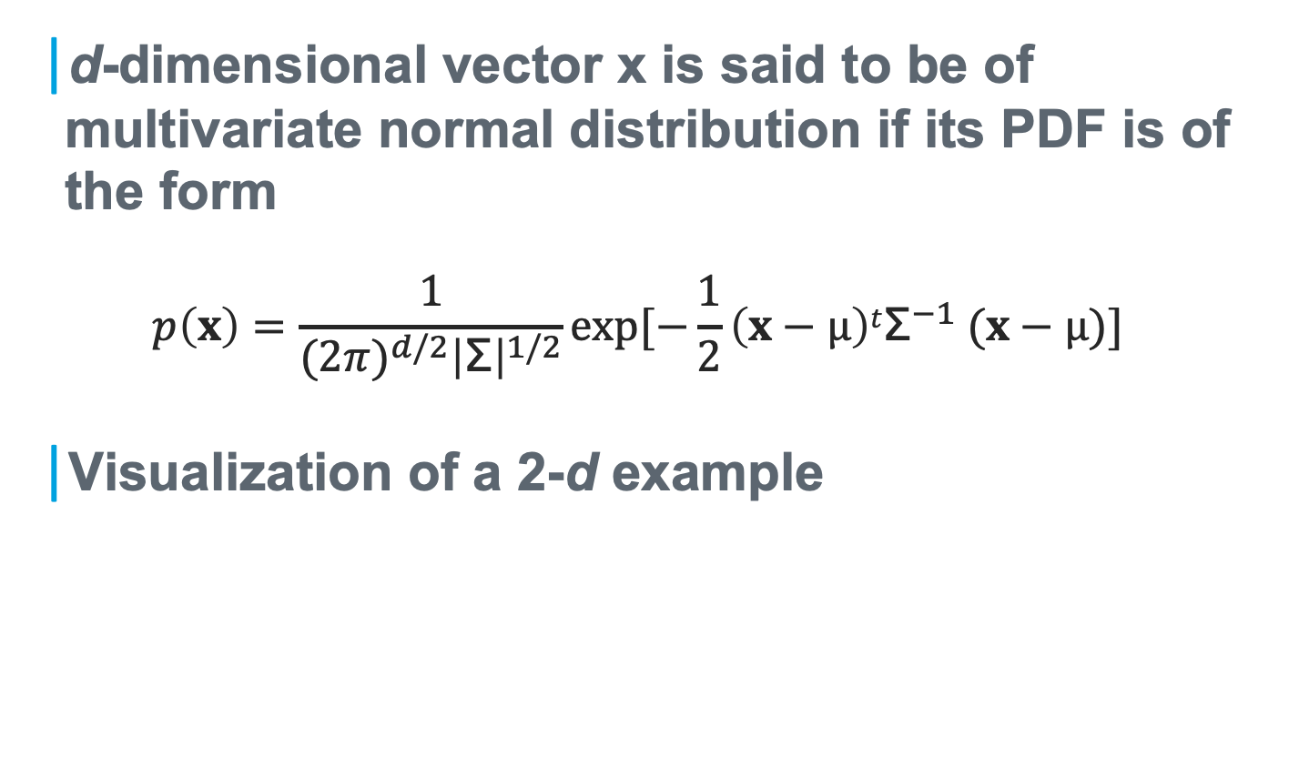
Multivariate Normal Distribution
d-dimensional vector x is said to be of multivariate normal distribution if its PDF is of the form
$$p\left(x\right)=\frac{1}{{(2π)}^{d/2}{\left|\text{Σ}\right|}^{1/2}}exp⁡[−\frac{1}{2}\left(x−µ\right)t{\text{Σ}}^{−1} (x−µ)]$$
Visualization of a 2-d example

Slide 51
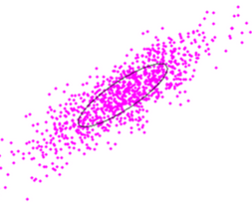
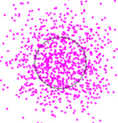
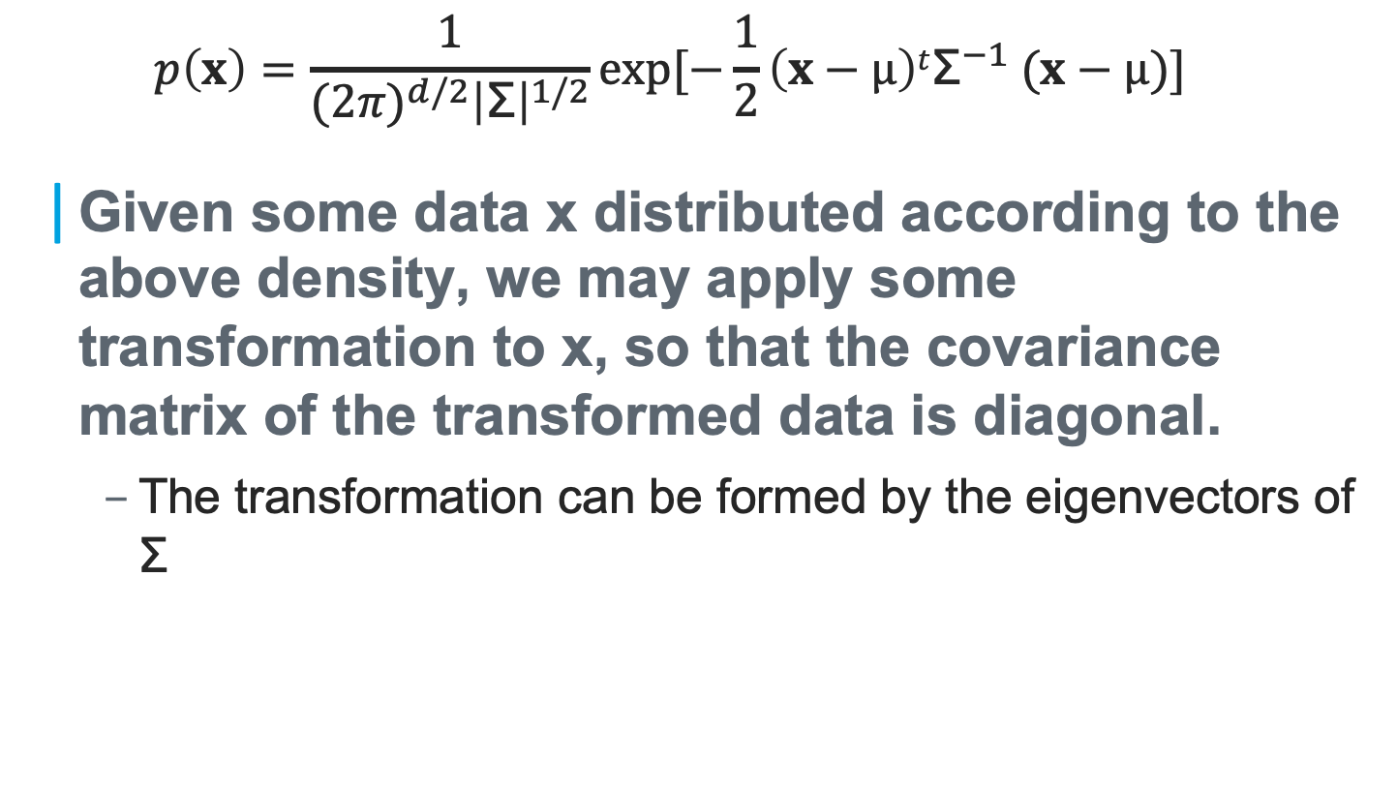
Whitening Transformation
$$p\left(x\right)=\frac{1}{{(2π)}^{d/2}{\left|\text{Σ}\right|}^{1/2}}exp⁡[−\frac{1}{2}\left(x−µ\right)t{\text{Σ}}^{−1} (x−µ)]$$
Given some data x distributed according to the above density, we may apply some transformation to x, so that the covariance matrix of the transformed data is diagonal.
The transformation can be formed by the eigenvectors of $\text{Σ}$

